Slide 1
Project 1
Lesson 7.1

Slide 2
Learning Objectives
Introduction to Agile Software Development
Minimal Viable Product (MVP)
Creating GitHub Issues and User Stories
Agile Meetings
Git Branching and Pull Requests
Project 1 – Groups and Starting

Slide 3

What is a project?
Notes:
We're about to begin our first project. But first, what is a project?

Slide 4

Project: Any undertaking, carried out individually or collaboratively and possibly involving research or design, that is carefully planned (usually by a project team) to achieve a particular aim.
Notes:
A project is "any undertaking, carried out individually or collaboratively and possibly involving research or design, that is carefully planned (usually by a project team) to achieve a particular aim." [Wikipedia: Project](https://en.wikipedia.org/wiki/Project)

Slide 5
How do we carefully plan a project?

Slide 6

Project Management
The practice of initiating, planning, executing, controlling, and closing the work of a team to achieve specific goals and meet specific success criteria at the specified time.
The primary challenge of project management is to achieve all of the project goals within the given constraints.
wikipedia.org

Slide 7
What is the definition of agile?

Slide 8
agile [ aj-uhl, -ahyl ]
01
Quick and well-coordinated in movement; lithe: an agile leap.
02
Active; lively: an agile person.
03
Marked by an ability to think quickly; mentally acute or aware: She's 95 and still very agile.
dictionary.com
Notes:
According to dictionary.com, agile is "quick and well-coordinated in movement".

Slide 9
What is agile software development?
Notes:
What do we think "agile" means in terms of software development?

Slide 10
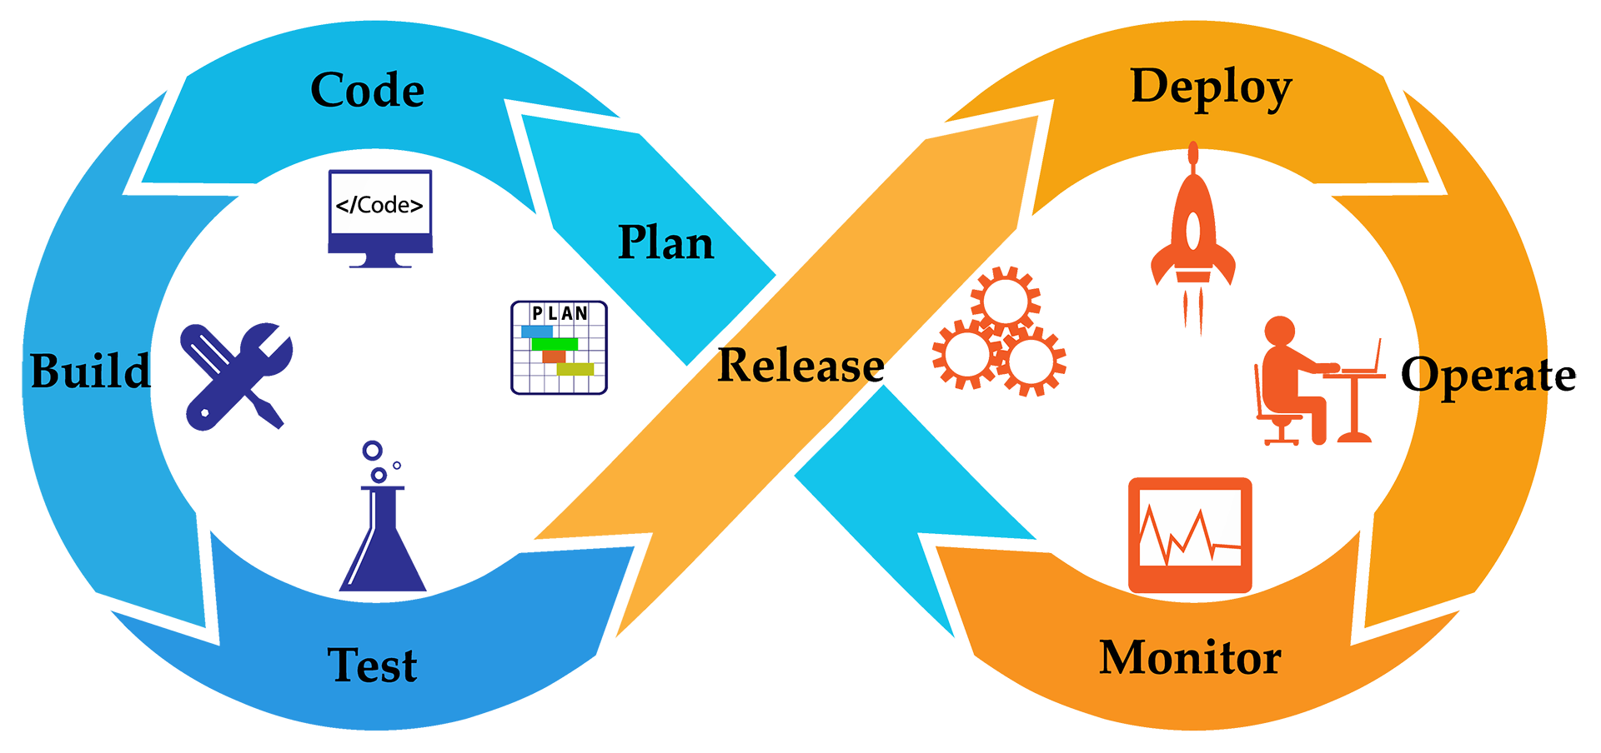
Agile Software Development
Agile software development is an iterative approach to software development.
wikipedia.org
Notes:
Agile software development is an iterative approach to developing software. Teams deliver value to their customers faster by working incrementally rather than working towards a big launch. Teams improve and respond to change by continuously evaluating project plans, requirements and user needs.

Slide 11
Agile Software Development
Deliver Value
Respond to Change
Teams deliver value to their customers faster by working incrementally rather than working towards a big launch.
Teams improve and respond to change by continuously evaluating project plans, requirements and user needs.

Slide 12
What is iterative development?
Notes:
What is _iteration_? If iteration is the repetition of a process in order to generate a sequence of outcomes, what is _iterative development_?

Slide 13
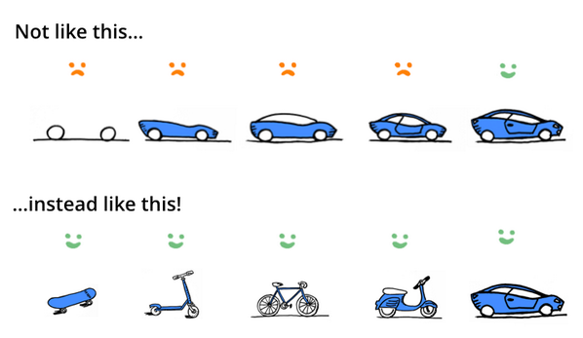
Iterative and Incremental Development
Working software is the primary measure of progress
Notes:
In an iterative approach to development, working software is the primary measure of progress. Our goal is to build functional applications, even if they are very simple, like a skateboard. If we set out to build a sports car, we may never get there and we will have unhappy customers along the way.

Slide 14
What is an MVP?

Slide 15


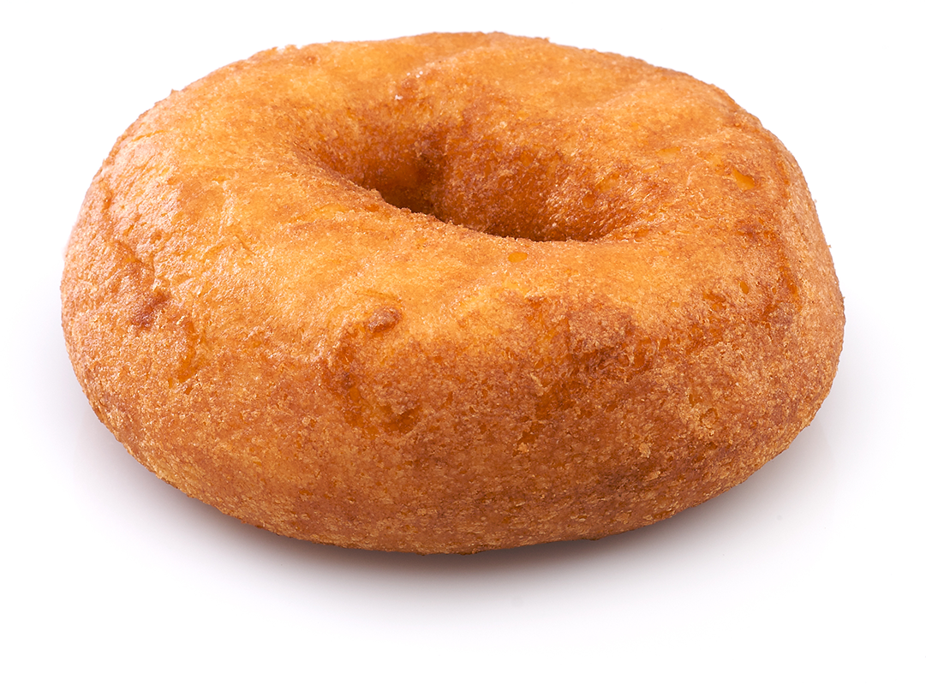
Minimum Viable Product
A product with just enough features to satisfy early customers and provide feedback for future product development
Minimum Viable Product: Product Vision:
wikipedia.org
Notes:
Shutterstock_46018207
shutterstock_107698130

Slide 16
How do we determine our MVP?
Notes:
How do we know what our minimum viable product is?

Slide 17

Determining a Minimum Viable Product
Ask Questions!
Who is your audience?
What is the problem that the product will address?
How does the product solve that problem?
Notes:
There are a lot of approaches to defining a minimum viable product, but we can simplify it to three questions: 1) who is your audience?; 2) what is the problem that the product will address?; 3) how does the product solve that problem?

Slide 18
What is a user story?
Notes:
In software development and product management, a user story is an informal, natural language description of one or more features of a software system. User stories are often written from the perspective of an end user or user of a system. [Wikipedia: User story](https://en.wikipedia.org/wiki/User_story)

Slide 19
User stories
As a <type of user>
Who are we building this for?
AS A marketing analyst
I want <some goal>
What is the user trying to achieve?
I WANT to see referral traffic
(so that <benefit>).
Why do they want to achieve this?
SO THAT I can convert more leads

Slide 20
User stories
As a <type of user>
Who are we building this for?
AS A marketing analyst
I want <some goal>
What is the user trying to achieve?
I WANT to see referral traffic
(so that <benefit>).
Why do they want to achieve this?
SO THAT I can convert more leads

Slide 21
User stories
As a <type of user>
Who are we building this for?
AS A marketing analyst
I want <some goal>
What is the user trying to achieve?
I WANT to see referral traffic
(so that <benefit>).
Why do they want to achieve this?
SO THAT I can convert more leads

Slide 22
What is acceptance criteria?
Notes:
Acceptance criteria define the boundaries of a user story and are used to confirm when a story is completed and working as intended. [Wikipedia: Acceptance criteria](https://en.wikipedia.org/wiki/User_story#Acceptance_criteria)

Slide 23
User stories
GIVEN some precondition
GIVEN I am an authenticated user
WHEN I do some action
WHEN I request a range of referral traffic
THEN I expect some result
THEN a chart is generated

Slide 24
User stories
GIVEN some precondition
GIVEN I am an authenticated user
WHEN I do some action
WHEN I request a range of referral traffic
THEN I expect some result
THEN a chart is generated

Slide 25
What is an Issue?
Notes:
Use issues to track ideas, enhancements, tasks, or bugs for work on GitHub.

Slide 26
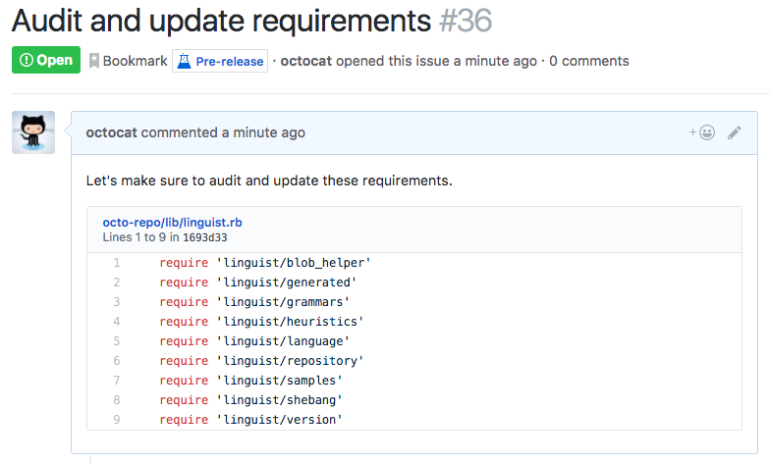
Issues
Use issues to track ideas, enhancements, tasks, or bugs for work on GitHub.
help.github.com
Notes:
Demo next slide

Slide 27
Issues
Notes:
* Use the prompts and talking points below to demonstrate the following key point(s):
- ✔️ Creating an Issue on GitHub
- ✔️ Writing a user story
* Navigate to [GitHub.com](https://github.com) in your browser and explain the following point(s):
- When we open a project repository, we see next to the `Code` tab an `Issues` tab.
- If we navigate to the `Issues` tab, we will see any open Issues.
- If we click the green `New Issue` button, we are routed to a form where we can create a new issue.
- When we create an Issue, we want to give it a descriptive and accurate title:
```md
See referral traffic for inbound analysis
```
```md
AS A marketing analyst
I WANT to see referral traffic
SO THAT I can adapt strategy to convert more leads
```
- We also want to add acceptance criteria:
```md
GIVEN I am an authenticated user
WHEN I request a range of referral traffic
THEN a chart is generated
```
* Ask the class the following question(s) and call on students for the corresponding answer(s):
- ☝️ What is the difference between user stories and issues?
- 🙋 User stories are informal descriptions, whereas issues are our way of tracking features, tasks, bugs, or other improvements.

Slide 28
Student Activity: 1-user-stories User stories help provide context for a development team and their efforts moving forward
Notes:
5 minutes
1-user-stories
Create a user story (writing it out only)

Slide 29
What is kanban?

Slide 30



Kanban
Kanban is a project management tool that visualizes work through cards representing User Stories or Issues.
In their simplest form, Kanban boards are broken into three columns:
To Do | In Progress | Done
Cards begin in the To Do column and are moved from left to right as work is started and completed.
Notes:
Kanban is a project management tool that visualizes work through cards representing User Stories or Issues. In their simplest form, Kanban boards are broken into three columns: To Do; In Progress; Done. Cards begin in the To Do column and are moved from left to right as work is started and completed.

Slide 31
Kanban
Notes:
- Use the prompts and talking points below to demonstrate the following key point(s):
- ✔️ Creating a Project on GitHub
- ✔️ Adding Issues to a Project
- Navigate to [GitHub.com](https://github.com) in your browser and explain the following point(s):
- We start by creating a repository for our new project.
- After creating a repository we can set up tracking for our project by selecting the projects tab and clicking on `Create a Project`.
- Here, we'll name our project and select the Basic Kanban template.
- Now we can an issue to our board by clicking the `+` icon in the To do column.
- Alternatively, we can click on `+ Add cards` in the top right to add an existing issue as a card to our project.
- When the status of a card changes, we update the board by dragging the card into its appropriate column.
- 🎗 Remember you can also create an issue by navigating to the `Issues` tab. If you decide to add it to a project, you can select which project the issue is associated with on the right side.
- Ask the class the following question(s) and call on students for the corresponding answer(s):
- ☝️ Why do we use Kanban boards to track the status of our project.
- 🙋 Kanban boards help you and your team visualize the status of the project. Another advantage of Kanban is that it's much less complex to manage than many other popular methods of project management.

Slide 32
Student Activity: 2-github-projects Kanban boards help developers visualize work and keep track of the status of issues.
Notes:
10 minutes
Create a github repo and experiment with tracking issues

Slide 33
What is daily scrum?

Slide 34
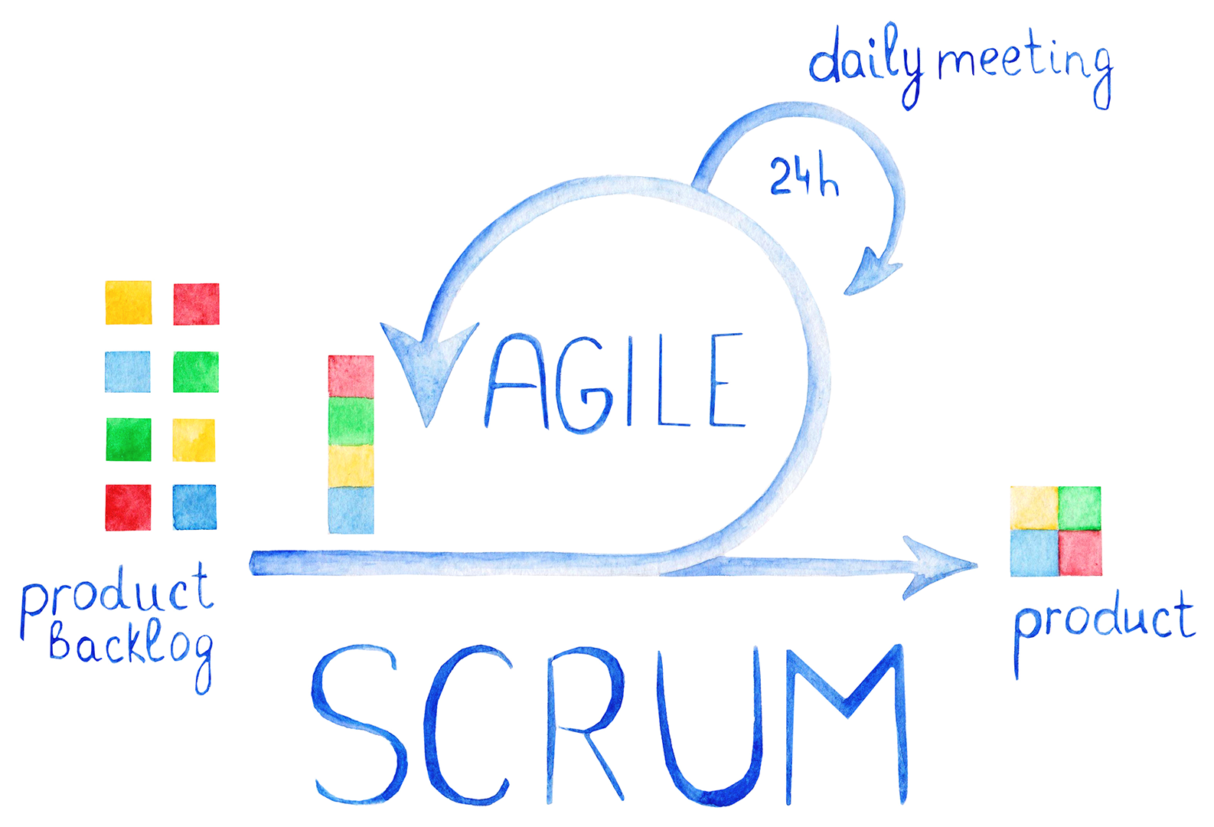
Stand-Up Meetings
01
What was accomplished?
02
What are your goals?
03
Are there any obstacles to achieving your goals?
Notes:
Stand-up meetings are used to hold teams accountable to each other. Team members make commitments to work on aspects of the project and report out progress. Stand-up meetings are useful in identifying issues as they arise and developing plans to resolve them. There are generally three questions each team member answers in a stand-up: 1) What was accomplished?; 2) What are your goals?; 3) Are there any obstacles to achieving your goals? [Wikipedia: Stand-up meeting](https://en.wikipedia.org/wiki/Stand-up_meeting)

Slide 35

Project Timeline
Day 1 | Day 2
Divide into groups. Write a user story. Create a wireframe. Create a user flow diagram. Submit project proposal for approval. | Dive in to project development.
Day 3 | Day 4
Continue project development. | Continue project development.
Day 5 | Day 6
Continue project development. Prepare for presentations. | Give presentations!
Notes:
On the first day, we'll divide into groups, write a user story, create a wireframe, create a user flow diagram, and submit a project proposal for approval. We will continue to work on project development until project presentations on the sixth day.

Slide 36

Get Professional
Projects are portfolio pieces
Use Project Week as an opportunity to push yourself and prove what you know.
Notes:
Remember, projects are your portfolio pieces. Use project week as an opportunity to push yourself and prove your knowledge. Keep you MVP simple and add features as you go to avoid feature creep.

Slide 37
Project Requirements
Must use at least two server-side APIs
Must use a CSS framework other than Bootstrap
Use at least one new third-party API
Must have a polished, mobile-first UI
Must meet good quality coding standards (indentation, scoping, naming, etc.)
Does NOT use alerts, confirms, or prompts (look into modals).
Must be deployed to GitHub Pages
Must be interactive (i.e: accept and respond to user input)

Slide 38
Presentation Requirements
You will be responsible for preparing a formal, 10-minute presentation that covers the following:
Elevator pitch: a one minute description of your application
Concept: What is your user story? What was your motivation for development?
Process: What were the technologies used? How were tasks and roles broken down and assigned? What challenges did you encounter? What were your successes?
Demo: Show your stuff!
Directions for Future Development
Links to to the deployed application and the GitHub repository

Slide 39
Project Metrics
Your project will be evaluated on the following:
Concept
Design
Functionality
Collaboration
Presentation
Notes:
Your project will be evaluated on its concept, design, functionality, collaboration, and presentation.

Slide 40
API Suggestions
Stick to APIs that do all of the following:
Allow cross-origin resource sharing (CORS)
Require simple or no authentication
Return a JSON response
Are well documented
For a list of free APIs see: https://github.com/public-apis/public-apis
Notes:
It is recommended that you use an API that: Allows CORS, requires simple or no authentication, uses JSON, is well documented.

Slide 41
Today’s Project Checklist
Create a short (1 page) proposal that contains the following:
Project title
Project description
User story
Wireframe or sketch of the design
APIs to be used
Rough breakdown of tasks
Notes:
Create a 1 page proposal that contains: Project title, project description, user story, wireframe or sketch of the design, APIs, rough breakdown of tasks.

Slide 42
Project 1 Groups
Group 1
Richard, Spencer, Alex
Group 2
Kaitlyn, Remy, Marie
Group 3
Andrea, Max, Randy
Group 4
Issouf, Duc, Lisa, Esther
Group 5
Rachel, Khangai, Jared
Group 6
Lloyd, Owen, Henry, Ben
Group 7
Frantz, Teresa, Ryan
Group 8
George, Justin, Ari
Notes:
40 min
- Direct students to begin to work with their groups to identify ideas, research APIs, and create project designs.
- Many of you may only have a rough idea of what your project will consist of. This is a good opportunity to rule out ideas and get a good sense of what is feasible.
- Be cautious of underestimating the amount of time that features will take to implement. Try thinking of the MVP for each idea and attempt to pick the idea that excites your group and seems feasible in the time you have.
After break we will be starting on the three activities

Slide 43
BREAK!
Notes:
15 min break

Slide 44
Group Activities
00-Plan when/where/how you want to meet together
01-Stu_Create-Repository
02-Stu_Protect-Master
03-Stu_Branching-Pushing
Notes:
Till the end of class (75 minutes)

Slide 45
Questions?

